Slide 1
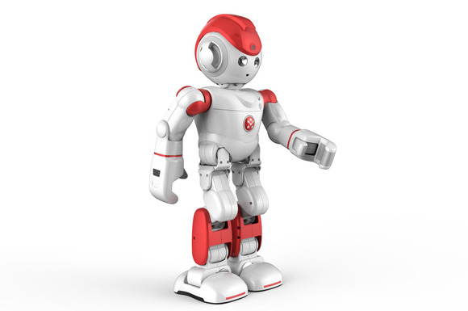
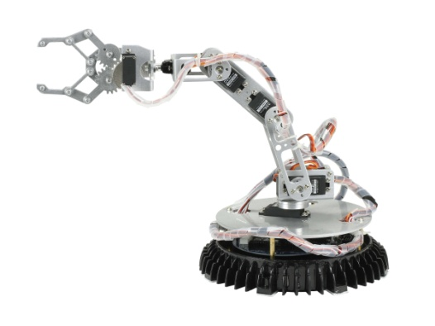
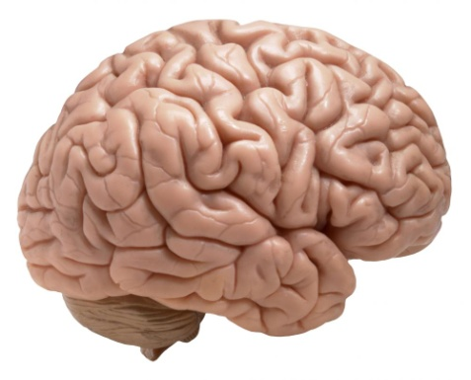
Artificial Intelligence
It is a study of how to make computers “do things” that are at a moment done better by people.
AI is Artificial Intelligence till it is achieved; After which AI reduces to Already Implemented.

Slide 2
Intelligence
“The capacity to learn and solve problems”
in particular,
1. the ability to solve novel problems
2. the ability to act rationally
3. the ability to act like humans.
Artificial Intelligence
1. Build and understand intelligent entities or agents
2. Main approaches: “engineering” versus “cognitive
modeling”

Slide 3
AI Problems
Game Playing
Theorem Proving Both need above average intelligence
Every day tasks -- > Common sense reasoning → General Problem Solving (GPS)
No need for large knowledge base about a particular problem domain. Only simple tasks are chosen
Example : Pick and place, Track a path, Move in a given direction etc.

Slide 4
AI Problems
Ability to handle large Knowledge base
Having done basis tasks, new tasks could be attempted
Perception -- Vision and Speech
Natural language understanding
Problem solving in specialized domains
Medical diagnosis or Chemical analysis
Perception : Knowing the world around -- > Crucial to survival
Perceptual task is difficult --? It involves analog data rather than digital data
Understanding language is an AI task so also is translation
.

Slide 5
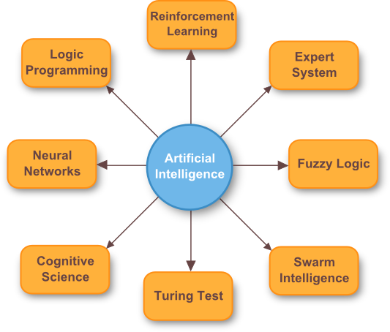
AI Problems
More Specialized tasks
Requires high intelligence -> Engineering Design, Scientific discovery, Financial analysis and planning

Slide 6
AI Problems - Broad categories
Vision, Speech
Understanding and Translation, Reasoning, Robot control
Mundane Tasks
Games – Chess, Checkers
Maths – Geometry, Logic
Proving Theorems, Integral calculus
Formal Tasks
Expert Tasks
Engineering – Design, Fault finding, Planning
Scientific analysis
Financial Analysis

Slide 7
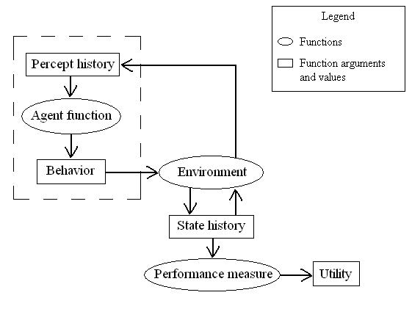
AI Scope and Future
AI is flourishing as a practical discipline and not as a pure research
Expert Systems various engineering domains provide part or full solutions to all practical problems that previously required human expertise(Which is scarse)

Slide 8
Underlying Assumptions
Physical Symbol Hypothesis
• e.g. Turing machine model of information- processing
• associated with classical, symbolic AI
Symbols are physical patterns
Symbols can be combined to form complex symbol structures
The system contains processes for manipulating complex symbol structures
The processes for representing complex symbol structures can themselves by symbolically represented within the system

Slide 9
Underlying Assumptions
Physical Symbol System Hypothesis(PSSH)
Basic components of a representation
• description of given situation
• operators for changing the situation
• a goal situation
• tests to determine whether the goal has been reached

Slide 10
Underlying Assumptions
Examples of physical symbol systems include:
Formal logic: the symbols are words like "and", "or", "not", "for all x" and so on. The expressions are statements in formal logic which can be true or false. The processes are the rules of logical deduction.
Algebra: the symbols are "+", "×", "x", "y", "1", "2", "3", etc. The expressions are equations. The processes are the rules of algebra, that allow one to manipulate a mathematical expression and retain its truth.
A digital computer: the symbols are zeros and ones of computer memory, the processes are the operations of the CPU that change memory.
Chess: the symbols are the pieces, the processes are the legal chess moves, the expressions are the positions of all the pieces on the board.
The physical symbol system hypothesis claims that both of these are also examples of physical symbol systems:
Intelligent human thought: the symbols are encoded in our brains. The expressions are thoughts. The processes are the mental operations of thinking.
A running artificial intelligence program: The symbols are data. The expressions are more data. The processes are programs that manipulate the data.

Slide 11
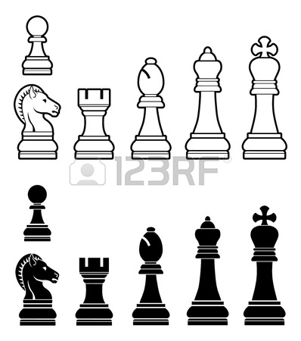

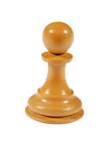
Underlying Assumptions
Physical Symbol System Hypothesis(PSSH)
Problem space = branching tree of achievable situations defined by potential application of operators to initial situation
[e.g. chess]
Physical Symbol System Hypothesis : A physical system has necessary and sufficient means for general intelligent action.
Ex. Symbol → Pawn on chess board Action -> Legal move

Slide 12
AI Technique
AI problems span a broad spectrum.
“Are there any techniques that are appropriate for solution of a variety of these Problems?”
Ans : Yes…
All AI techniques require knowledge to act on symbols…
Properties of knowledge : It is voluminous, Hard to characterize, constantly changing, Differs from data being organized that it is used.

Slide 13
Definition of AI Technique
“AI technique is a method that exploits knowledge and should be represented such that”
Knowledge captures generalizations.
Is to be understood by people who use it.
It can be easily modified to correct errors and reflect real world
It can be used in great many situations
It can be used to help overcome its own sheer bulk by narrowing the range of possibilites.

Slide 14
Examples :
Tick Tack Toe…

Slide 15
Level of the Model
Question :
“What is our goal in trying to produce programs that do the intelligent things that people do?”
Goals :
1. Produce programs that do tasks the same way people do..
2. Produce programs that simply do the tasks whatever way
appears easiest.

Slide 16
Level of the Model
Goal 1 Model
Produce programs that do tasks the same way people do..
Programs that do not fit our definition of AI task
Problems the computer can easily solve : Memorizing syllables
Programs that Attempt to model human performance and fit our definition of AI task
Problems that are non-trivial for a computer : Read news paper story and answer a question

Slide 17
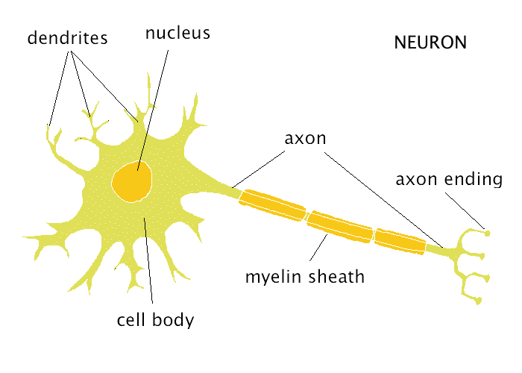
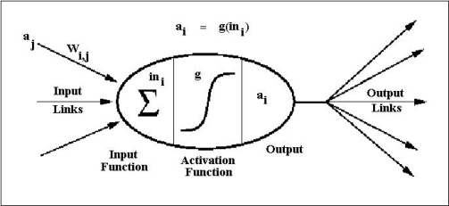
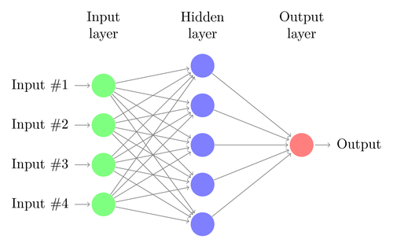
Level of the Model
McClloch & Pitts Model
Based on Biological Neuron called perceptrons, but this failed to produce minimal intelligent behavior. Newer Neural network architectures were proposed that have overcome limitations of perceptrons. All neurons in the NN work parallelly as do a human brain works.

Slide 18
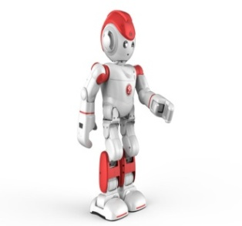
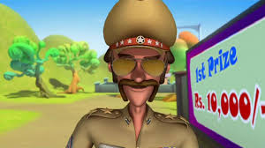

Criteria for Success
Turing Test
Room 1 | Room 2
A
B

Slide 19
One Final word and Beyond
We must do our best to develop programs to solve AI tasks to help understand how human beings think and act..
All AI techniques must contain a lot of knowledge..if it has to solve some non-trivial problems
But as size of knowledge grows, it becomes harder to access appropriate things when needed.

